Slide 1
Fundamental Concepts of Java Programming Language
What we Learn?
Identifiers
Rules to define java identifiers:
Keywords
Data Types

Slide 2
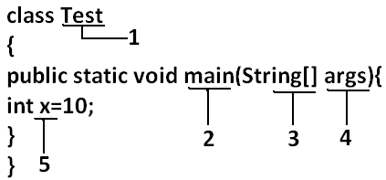
Identifier :
A name in java program is called identifier. It may be class name, method name, variable name and label name.

Slide 3
Rules to define java identifiers:
Java identifiers obey the following rules that are as follows:
Java identifier is a sequence of characters that consists of letters, digits, underscores (_), and dollar signs ($).
It must start with a letter, an underscore (_), or a dollar sign ($). It cannot begin with a digit.
It cannot be a reserved word.
It cannot be true, false, or null.
It can be of any length.
All identifiers are case sensitive.
Blank space are not allowed

Slide 4
Naming Conventions:
Identifiers in Java should be meaningful and can be easily read. There are some naming conventions that are followed by Java programmers.
They are as:
The names of all public instance variables and methods begin with a leading lowercase (small) letter. For example, average, sum, etc.
If more than one word is used in a name, the second and subsequent words must start with a leading uppercase letter. For example, dayTemperature, totalMarks, schoolId, etc.
All private and local variables start with only lowercase letters combined with underscores. For example, length, student_id, etc.

Slide 5
Naming Conventions:
All classes and interfaces must begin with a leading uppercase letter and each subsequent word with a leading uppercase letter. For example, Student, HelloJava, Vehicle, etc.
Variables that are initialized with constant values, must start with a leading uppercase letter and can place underscores between words.
For example, TOTAL, PRINCIPAL_AMOUNT, etc.

Slide 6
Reserved words:
The Reserved Words in Java are pre-defined for some special purpose and you cannot create a variable, class name, or method name with these names.
It is used to represent functionality in programs.
They can be briefly categorized into two parts:
1) keywords(50) and
2) literals(3).

Slide 7
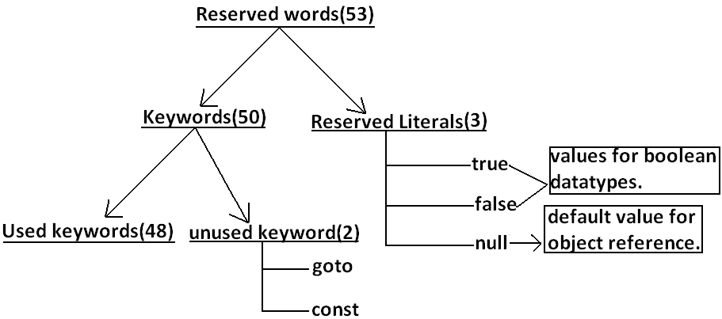
Reserved words:

Slide 8
List of Java Keywords:
abstract | assert | boolean | break | byte
case | catch | char | class | const
continue | default | do | double | else
enum | extends | final | finally | float
for | goto | if | implements | import
instanceOf | int | interface | long | native
new | package | private | protected | public
return | short | static | strictfp | super
switch | synchronized | this | throw | throws
transient | try | void | volatile | while

Slide 9
Reserved words for data types: (8)
1) byte
2) short
3) int
4) long
5) float
6) double
7) char
8) boolean

Slide 10
Reserved words for flow control: (11)
1) if
2) else
3) switch
4) case
5) default
6) for
7) do
8) while
9) break
10) continue
11) return

Slide 11
Keywords for modifiers:(11)
1) public
2) private
3) protected
4) static
5) final
6) abstract
7) synchronized
8) native
9) strictfp (1.2 version)
10) transient
11) volatile

Slide 12
Keywords for exception handling:(6)
1) try
2) catch
3) finally
4) throw
5) throws
6) assert (1.4 version)

Slide 13
Class related keywords:(6)
1) class
2) package
3) import
4) extends
5) implements
6) interface

Slide 14
Object related keywords:(4)
1) new
2) instanceof
3) super
4) this

Slide 15
Another keyword List:
If a method won't return anything compulsory that method should be declared with the void return type in java but it is optional in C++.
1) void
Unused keywords:
goto: Create several problems in old languages and hence it is banned in java.
const: Use final instead of this.
By mistake if we are using these keywords in our program we will get compile time error.
Reserved literals:
1) true values for boolean data type.
2) false
3) null ----------------- default value for object reference.

Slide 16
Another keyword List:
Enum:
This keyword introduced in 1.5v to define a group of named constants
Example:
enum Gender
{
MALE, FEMALE;
}
Conclusions :
All reserved words in java contain only lowercase alphabet symbols.
New keywords in java are:
strictfp -----------1.2v
assert -------------1.4v
enum --------------1.5v
In java we have only new keyword but not delete because destruction of useless objects is the responsibility of Garbage Collection.

Slide 17
Which of the following list contains only java reserved words ?
final, finally, finalize
throw, throws, thrown
break, continue, return, exit
goto, constant
byte, short, Integer, long
extends, implements, imports
finalize, synchronized
instanceof, sizeOf
new, delete

Slide 18
Which of the following are valid java keywords?
public
static
void
main
String
args

Slide 19
Points to remember:
Value assigned to the variable is called literal.
Instead of these keywords, you cannot use true, false, and null as identifiers because these are Literals.
The keywords const and goto are reserved, even though they are not currently used.
In place of const, the final keyword is used. Some keywords like strictfp are included in later versions of Java.
goto: Create several problems in old languages and hence it is banned in java.
const: Use final instead of const.
By mistake if we are using these keywords in our program we will get compile time error.

Slide 20
Data Types in JAVA
The Data Types in Java are basically used to store the data temporarily in the in the memory.
we have different types of data like integers, floating-point, characters, strings, etc. To store all these different types of data in a program to perform some operations.
The Data types provide you the following information:
Size of the memory location.
The range of data that can be stored inside that memory location
Possible legal operations that can be performed on that memory location.
What types of results come out from an expression when these types are used inside that expression.

Slide 21
Classification of Java Data Types:
Data types in Java are classified into two types:
Primitive Types:
Examples: Integer, Character, Boolean, and Floating Point.
Non-primitive Types:
Examples: Classes, Interfaces, and Arrays.
Except Boolean and char all remaining data types are considered as signed data types because we can represent both "+ve" and "-ve" numbers.
Note: Java is a strictly or strongly typed programming language i.e. before using the variable, first you need to declare it using data type (either primitive or non-primitive data type).

Slide 22
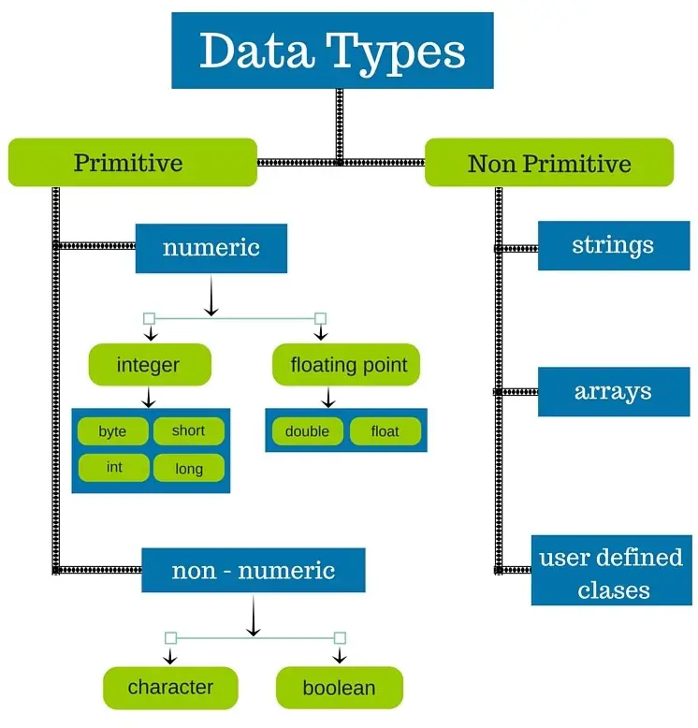
Classification of Java Data Types:

Slide 23
Integer Data Type:
Java defines four integer types: byte, short, int, and long.
All of these are can hold both signed, positive and negative values.
Byte Data Type:
The smallest integer type is a byte. [Size: 1 byte = 8 bits]
It is an 8-bit signed two’s complement integer and can hold a value between -128 to 127 (inclusive).
Range:-128to 127[-2^7 to 2^7-1] // 2 to the power 7
It means its minimum value is -128 and the maximum value is 127.
Its default value is 0.
byte data type is best suitable if we are handling data in terms of streams either from the file or from the network.
Use where the memory savings is most required.
Examples: byte b1 = 100; byte b2 = -100;

Slide 24
Short Data Type
The short Data Type in Java can hold a value between -32,768 to 32,767 (inclusive).
That means its minimum value is -32,768 and the maximum value is 32,767.
Its default value is 0.
It is a 16-bit signed two’s complement integer.
Like the Byte data type, the short can also be used to save memory as it is 2 times small than the int data type.
Size: 2 bytes
Range: -32768 to 32767(-2^15 to 2^15-1) // 2 to the power 15
Examples: short s1 = 8000; short s2 = -987;

Slide 25
int Data Type:
It is a 32-bit signed two’s complement integer and this data type can hold a value between -2,147,483,648 (-2^31) to 2,147,483,647 (2^31 -1) (inclusive).
That means its minimum value is -2,147,483,648 and the maximum value is 2,147,483,647.
Its default value is 0.
The int data type is generally used as a default data type for integral values unless there is no problem with memory.
Examples:
int num1 = 4578 ;
int num2 = 6688 ;

Slide 26
Long Data Type:
It is a 64-bit two’s complement integer and this data type can hold a value between -9,223,372,036,854,775,808(-2^63) to 9,223,372,036,854,775,807(2^63 -1)(inclusive).
minimum value i: -9,223,372,036,854,775,808
maximum value is 9,223,372,036,854,775,807
default value is 0.
Examples:
long l1 = 666777L;
long l2 = -222333L;

Slide 27
Floating-Point Data Types
Java Provides two data types to hold floating-point values.
Float Data Type
Double Data type
Float | double
If we want to 5 to 6 decimal places of accuracy then we should go for float. | If we want to 14 to 15 decimal places of accuracy then we should go for double.
Size:4 bytes. | Size:8 bytes.
Range:-3.4e38 to 3.4e38. | -1.7e308 to1.7e308.
float follows single precision. | double follows double precision.
its default value is 0.0F | its default value is 0.0d
Examples: float f1 = 123.4f; float f2 = 768.5f; | Examples: float f1 = 123.4; float f2 = 768.5;

Slide 28
Char Data Type:
In Java, the data types used to store characters are char.
Java uses Unicode to represent characters.
There are no negative chars.
Unicode defines a fully international character set that can represent all of the characters found in all human languages like Latin, Greek, Arabic, and many more.
This data type is a single 16-bit Unicode character and
Its value-ranges between ‘\u0000’ (or 0) to ‘\uffff’ (or 65,535 inclusive).
Example:
char ch = ‘A’;

Slide 29
Boolean Data Type:
It is used to store two possible values i.e. true or false.
The default value is false.
This data type in Java is basically used for simple flags that track true/false conditions.

Slide 30
Summary of java primitive data type:
data type | Size | Range | Corresponding Wrapper class | Default value
byte | 1 byte | -2⁷ to 2⁷-1(-128 to 127) | Byte | 0
short | 2 bytes | -2¹⁵ to 2¹⁵-1 (-32768 to 32767) | Short | 0
int | 4 bytes | -2³¹ to 2³¹-1 (-2147483648 to 2147483647) | Integer | 0
long | 8 bytes | -2⁶³ to 2⁶³-1 | Long | 0
float | 4 bytes | -3.4e38 to 3.4e38 | Float | 0.0
double | 8 bytes | -1.7e308 to 1.7e308 | Double | 0.0
boolean | Not applicable | Not applicable(but allowed values true|false) | Boolean | false
char | 2 bytes | 0 to 65535 | Character | 0(represents blank space)

Slide 31
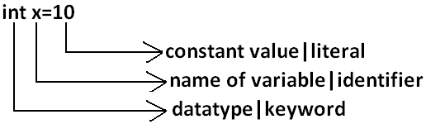
Literal in Java
Any constant value which can be assigned to the variable is called literal.
Example:

Slide 32
Types of Literals in Java:
There are five types of literal in Java :
Integer Literals
Floating-point Literals
Boolean Literals
Character Literals
String Literals

Slide 33
Integer Literals in Java:
Any whole number value is an integer literal.
The integer literal can be specified in four ways :
Decimal (Base-10): Digits from 0-9 are allowed in this form.
Example: int x=101;
Octal (Base-8): Digits from 0 – 7 are allowed. It should always have a prefix 0. Example: int x=0146;
Hexa-Decimal (Base-16):
The allowed digits are 0 to 9, A to Z.
For the extra digits we can use both upper case and lower case characters.
This is one of very few areas where java is not case sensitive.
Literal value should be prefixed with ox(or)oX.
Example: int x=0x10;
Binary: A literal in this type should have a prefix 0b and 0B, from 1.7 one can also specify in binary literals, i.e. 0 and 1. Example: int x = 0b1111;

Slide 34
Boolean Literal in Java:
There are only two logical values that a boolean value can have, true and false.
The values of true and false do not convert into any numerical representation.
The true literal in Java does not equal 1, nor does the false literal equal 0.
Example: boolean b = true;

Slide 35
Character Literal in Java:
A literal character is represented inside a pair of single quotes.
There are four types of character literal:
Single-Quote: Java Literal can be specified to a char data type as a single character within a single quote. Example: char ch = ‘a’;
Char as Integral: A char literal in Java can specify an integral literal which also represents the Unicode value of a character. Example: char ch = 062;
Unicode Representation: Char literals can specify in Unicode representation ‘\uxxxx’. Here XXXX represents 4 hexadecimal numbers. Example: char ch = ‘\u0061’; // Here 0061 represent a.
Escape Sequence: Escape sequences can also specify as char literal. Example: char ch = ‘\n’;

Slide 36
String Literals in Java:
Any sequence of characters with in double quotes is treated as String literal.
Example:
String s=“CDAC";

Slide 37
Which of the following are valid declarations?
int x = 0777;
int x = 0786;
int x = 0xFACE;
int x = 0xbeef;
int x = 0xBeer;
int x = 0xabb2cd;

Slide 38
Which of the following floating point declarations are valid?
float f = 123.456;
float f = 123.456D;
double d = 0x123.456;
double d = 0xFace;
double d = 0xBeef;

